Slide 1
Deca-Alanine Stretching
Free Energy Calculation from
Steered Molecular Dynamics Simulations
Using Jarzynski’s Equality
Sanghyun Park
May, 2002

Slide 2
Jarzynski’s Equality
T
T
λ = λ_{f}
λ = λ_{i}
λ = λ(t)
heat Q
work W
λ = end-to-end distance, position of substrate along a channel, etc.
2nd law of thermodynamics: ⟨W⟩ ≥ ΔF = F(λ_{f}) - F(λ_{i})
Jarzynski (1997): ⟨ exp (-βW) ⟩ = exp (-βΔF)
difficult to estimate

Slide 3
Derivation of Jarzynski’s Equality
Process described by
a time-dependent Hamiltonian H(x,t)
Trajectory x_{t}
External work W = ∫₀^{τ} dt ∂_{t}H (x_{t},t)
If the process
is Markovian: ∂_{t}f(x,t) = L(x,t) f(x,t)
satisfies the balance condition: L(x,t) exp[-βH(x,t)] = 0
Then, exp { -β [ F(τ) - F(0) ] } = ⟨ exp (-βW) ⟩
Isothermal MD schemes (Nose-Hoover, Langevin, …)
satisfies the conditions (1) and (2).

Slide 4
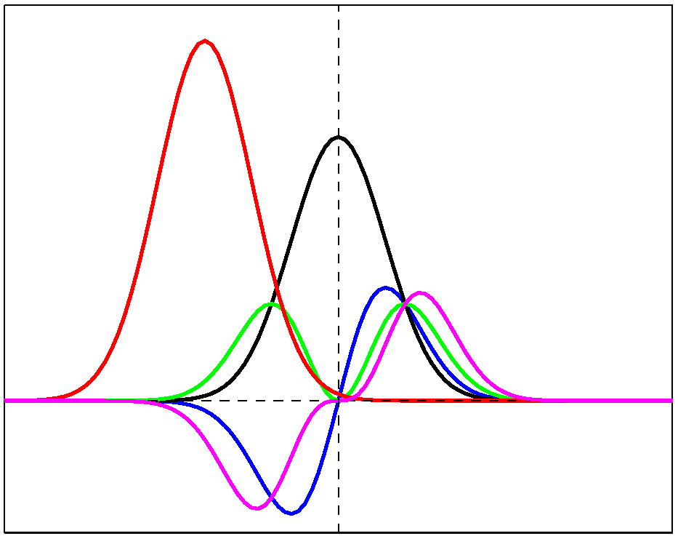
Cumulant Expansion of Jarzynski’s Equality
ΔF = - (1/β) log ⟨e^{-βW}⟩
= ⟨W⟩ - (β/2) ( ⟨W²⟩ - ⟨W⟩² )
+ (β²/6) ( ⟨W³⟩ - 3⟨W²⟩⟨W⟩ + 2⟨W⟩³ ) + •••
statistical error & truncation error
p(W)
shift ∼ σ² / k_{B}T
W × p(W)
shift/width ∼ σ / k_{B}T
W² × p(W)
width σ
W³ × p(W)
big in strong nonequilibrium
W
e^{-βW} × p(W)

Slide 5
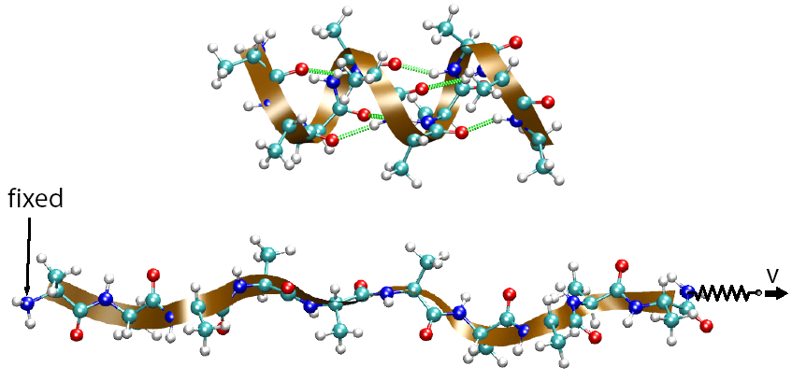
Helix-Coil Transition of Deca-Alanine in Vacuum
Main purpose:
Systematic study of the methodology of free energy calculation
- Which averaging scheme works best
with small number (~10) of trajectories ?
Why decaalanine in vacuum?
- small, but not too small: 104 atoms
- short relaxation time → reversible pulling → exact free energy

Slide 6
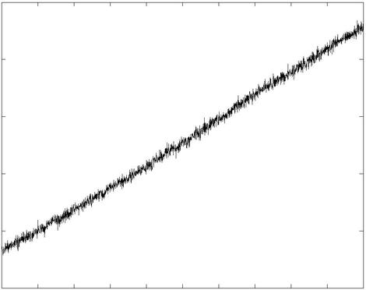
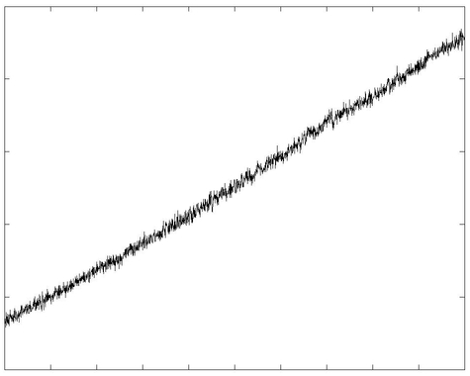
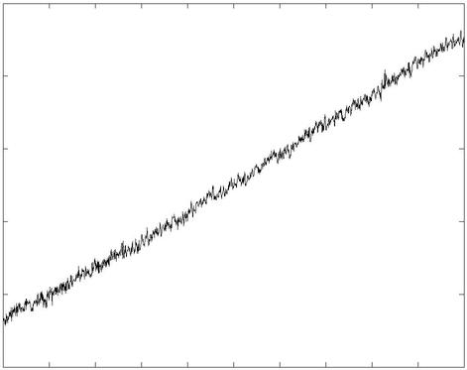
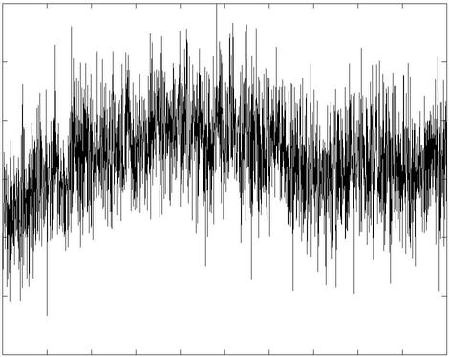
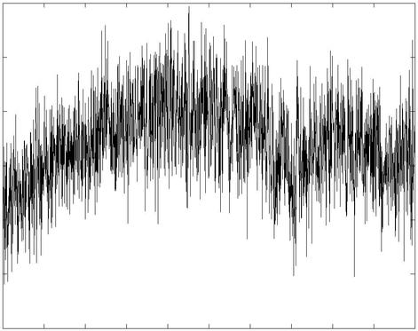
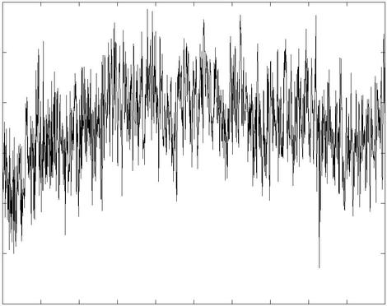
Typical Trajectories
v = 0.1 Å/ns
v = 10 Å/ns
v = 100 Å/ns
30
end-to-end distance (Å)
20
10
600
Force (pN)
0
-600
time
time
time

Slide 7
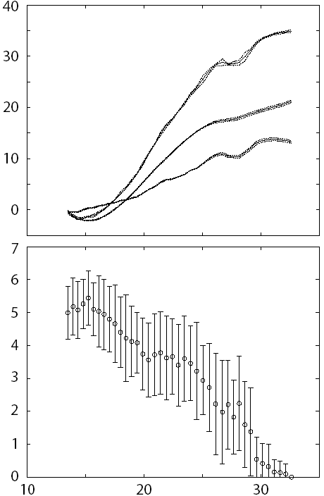
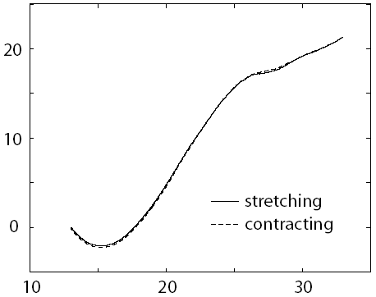
Reversible Pulling (v = 0.1 Å/ns)
E
reversible !
F
E, F, S (kcal/mol)
work W (kcal/mol)
TS
end-to-end distance (Å)
# of hydrogen bonds
ΔF = ⟨W⟩
TS = E - F
end-to-end distance (Å)

Slide 8
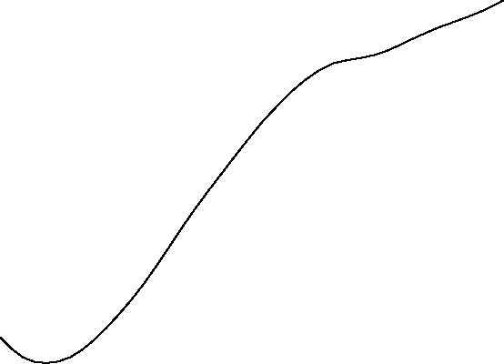
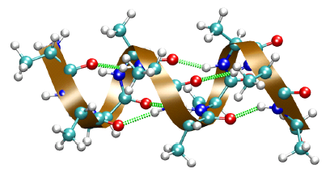
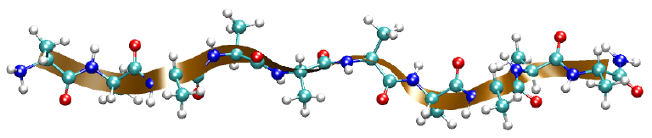
PMF and Protein Conformations

Slide 9
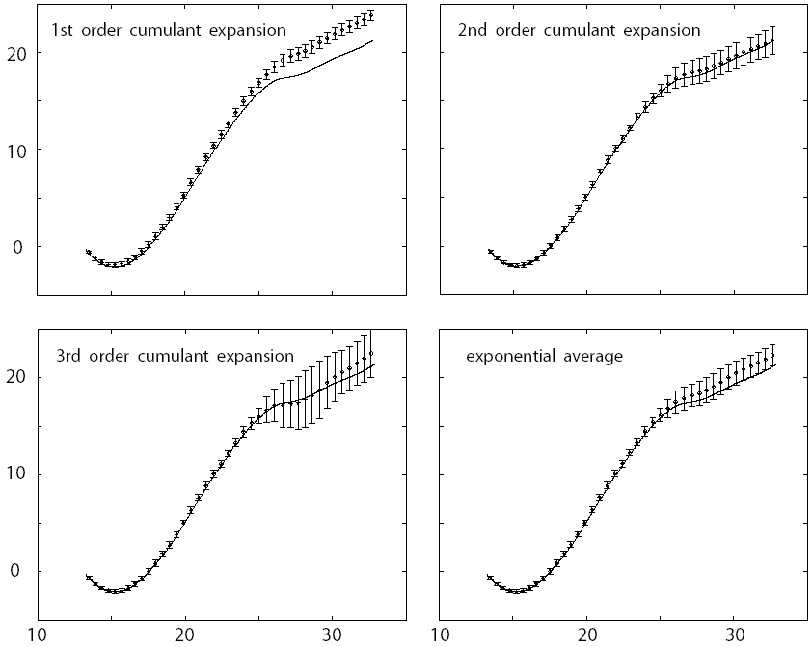
10 blocks of 10
trajectories
Irreversible Pulling ( v = 10 Å/ns )
PMF (kcal/mol)
winner
PMF (kcal/mol)
end-to-end distance (Å)
end-to-end distance (Å)

Slide 10
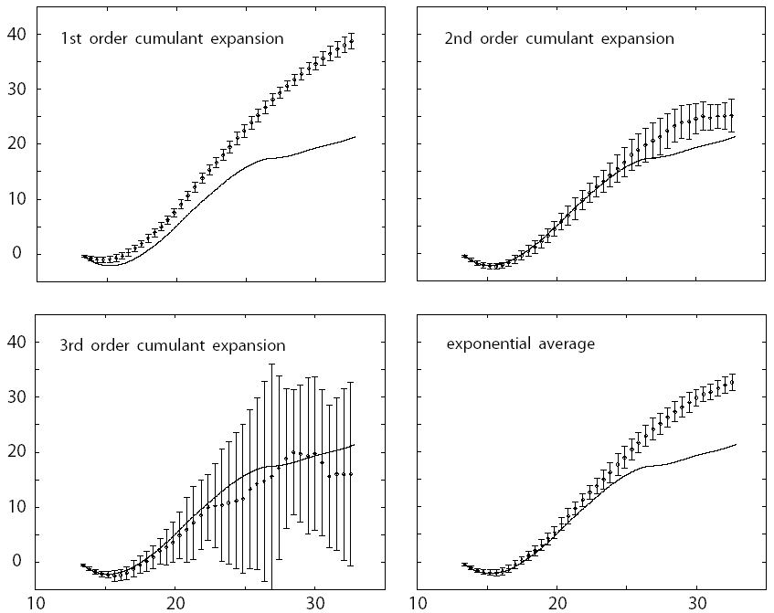
10 blocks of 10
trajectories
Irreversible Pulling ( v = 100 Å/ns )
PMF (kcal/mol)
winner
PMF (kcal/mol)
end-to-end distance (Å)
end-to-end distance (Å)

Slide 11
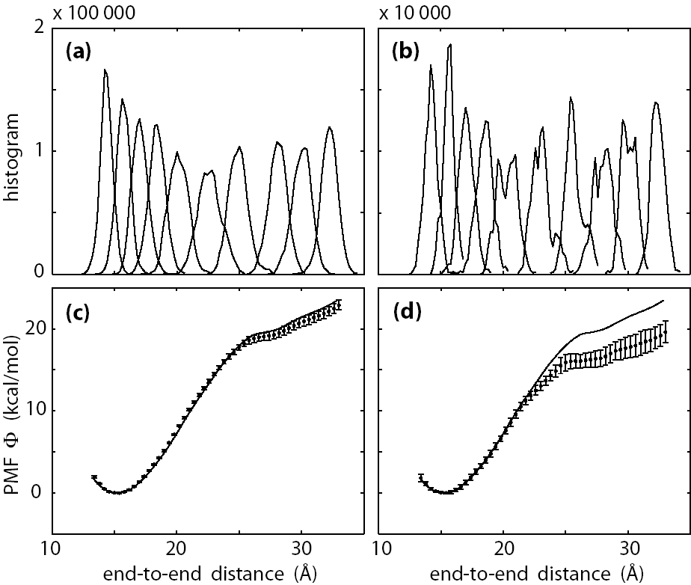
Umbrella Sampling w/ WHAM

Slide 12
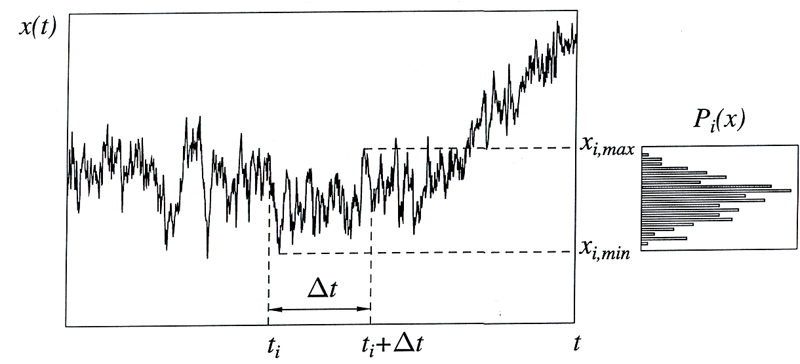
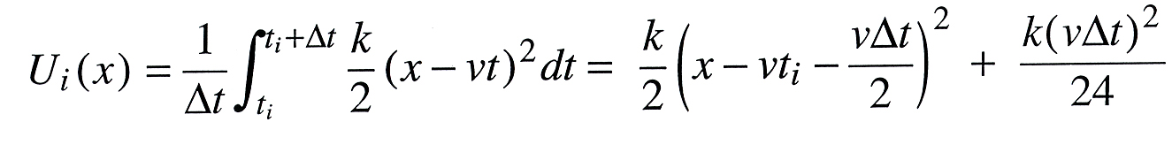
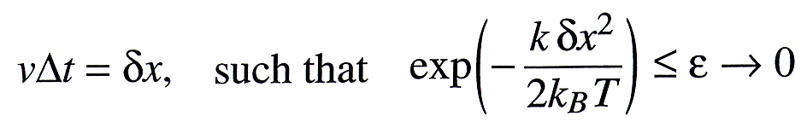
Weighted Histogram Analysis Method
SMD
trajectory
Biasing potential:
Choice of Δt:

Slide 13
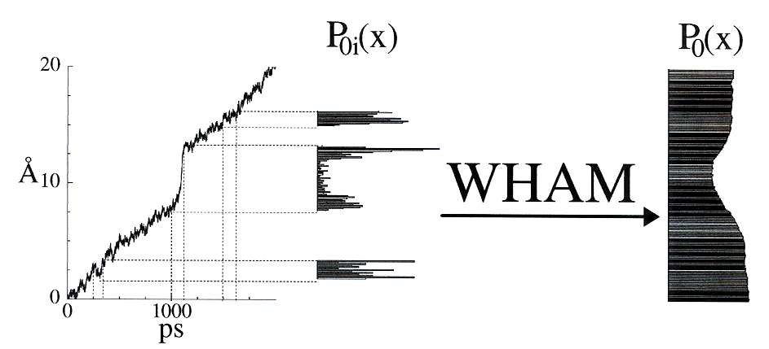
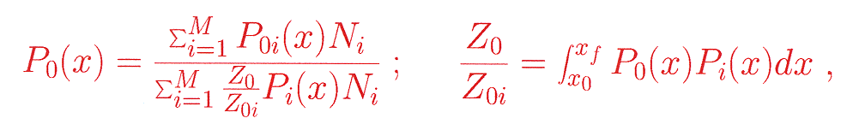
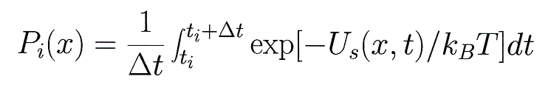
Weighted Histogram Analysis Method
P_{0i}(x), i = 1,2,…,M: overlapping local distributions
P₀(x): reconstructed overall distribution
Underlying potential:
U₀(x) = -k_{B}T ln P₀(x)
To reconstruct P₀(x) from P_{0i}(x) (i=1,2,…,M)
N_{i} = number of data points in distribution i,
Biasing potential: U_{s}(x,t) = k(x-vt)²
NIH Resource for Macromolecular Modeling and Bioinformatics
Theoretical Biophysics Group, Beckman Institute, UIUC

Slide 14
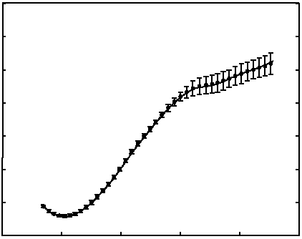
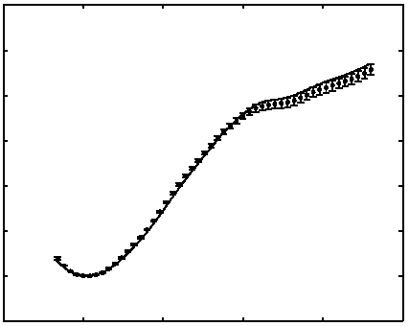
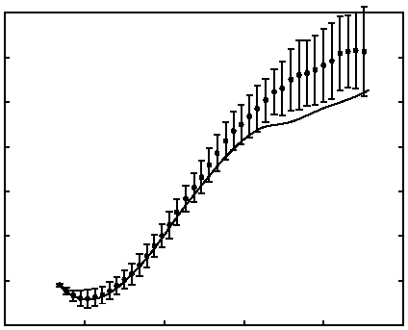
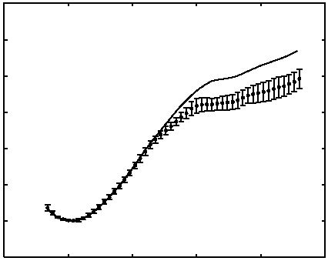
SMD-Jarzynski
Umbrella Sampling
(equal amount of simulation time)
simple analysis
uniform sampling of the reaction coordinate
coupled nonlinear equations (WHAM)
nonuniform sampling of the reaction coordinate

Slide 15
II. Finding Reaction Paths

Slide 16
Reaction Path - Background
Typical Applications of Reaction Path
• Chemical reaction
• Protein folding
• Conformational changes of protein

Slide 17
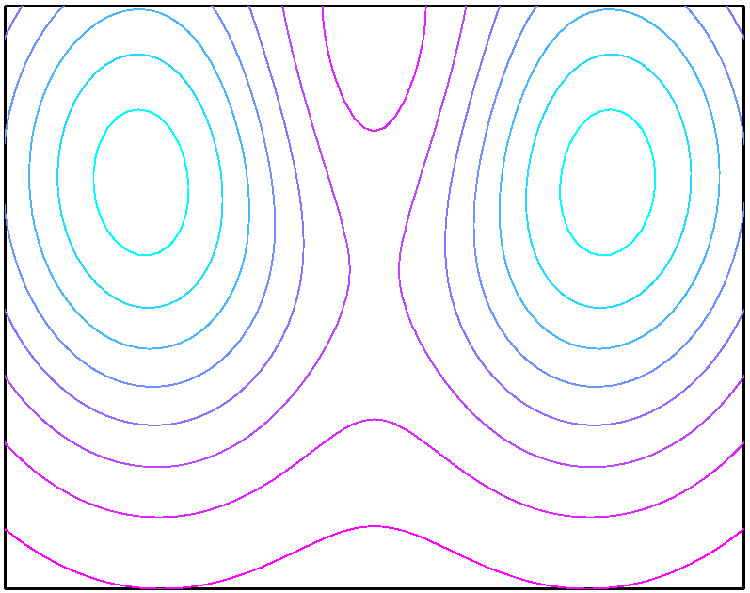
Reaction Path - Background
Reaction Path
steepest-descent path
for simple systems
complex systems
R
P
?
Reactions are stochastic: Each reaction event takes a different path
and a different amount of time.
⇒ Identify a representative path, revealing the reaction mechanism.

Slide 18
Reaction Path - Accomplishments
Reaction Path Based on the Mean-First Passage Time
Reaction coordinate r(x):
the location of x in the progress of reaction
r(x) = MFPT τ(x) from x to the product
MFPT τ(x) ← average over all reaction events
reaction path // -∇τ

Slide 19
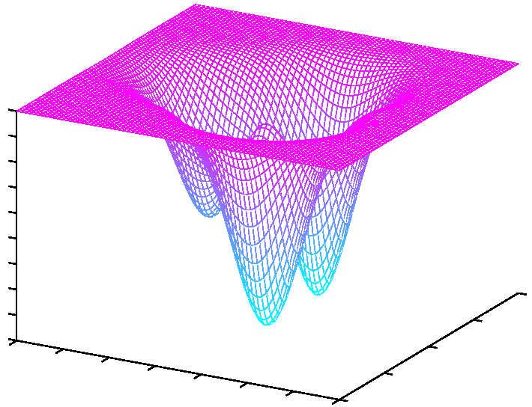
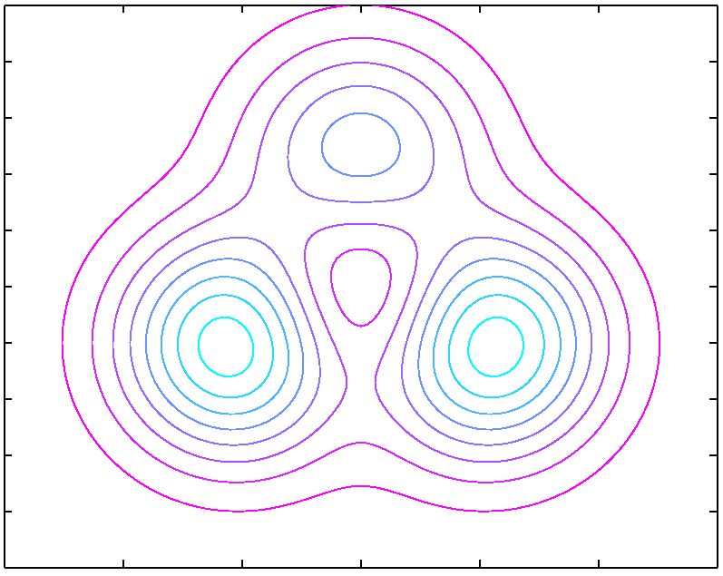
Reaction Path - Accomplishments
Brownian Motion on a Potential Surface
three-hole potential U(x)
0
-1
-2
R
P
-3
-4
Smoluchowski equation: ∂_{t}p = D∇⋅(e^{-βU} ∇(e^{βU} p))
→ -D∇⋅(e^{-βU} ∇τ) = e^{-βU}

Slide 20
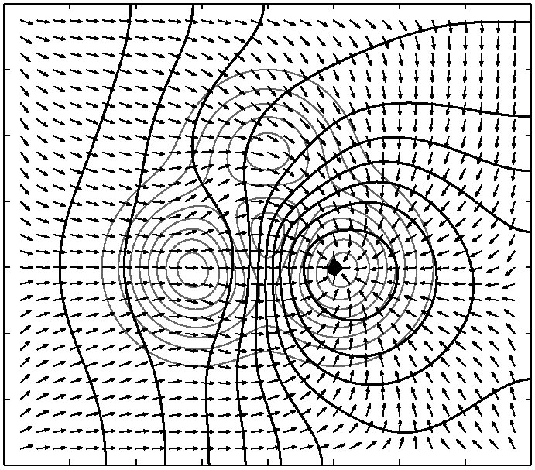
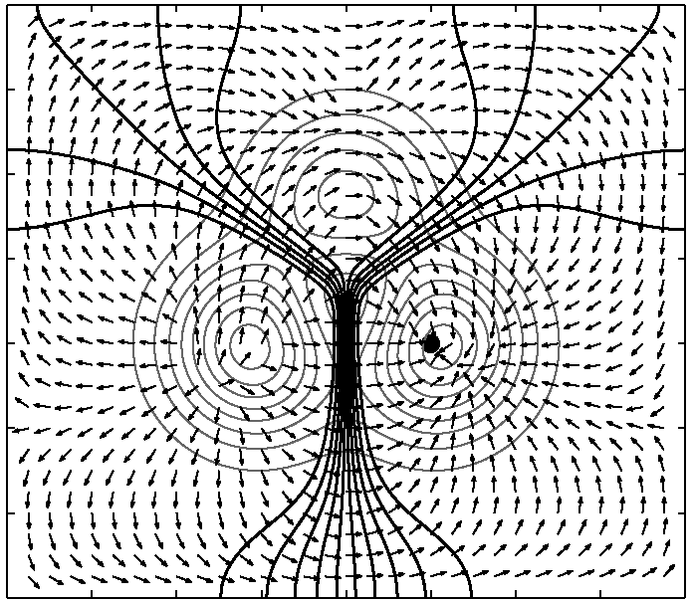
Reaction Path - Accomplishments
Brownian Motion on a Potential Surface
β = 1
β = 8

Slide 21
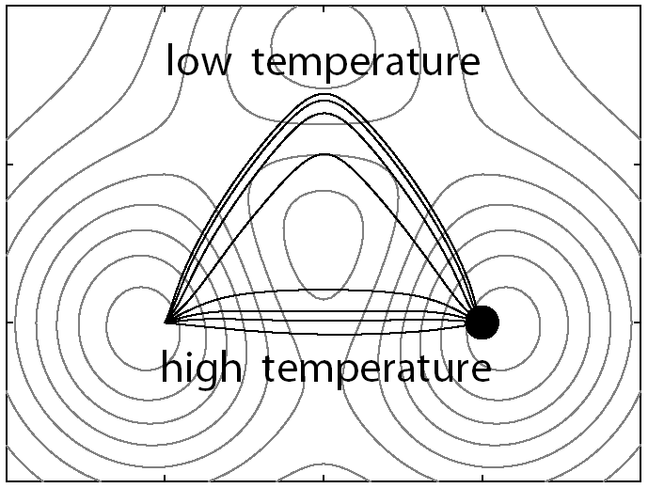
Reaction Path - Accomplishments
Brownian Motion on a Potential Surface
β = 8
•
•
•
β = 1

